Slide 1
Student Opinions Survey
By: Hannah Landrigan

Slide 2
I asked...
“Please detail below any concerns/questions/issues/suggestions you have pertaining to school that you would like reviewed by the school board.”

Slide 3
I visited...
Every advisory class over the course of a month explaining what the school board is and why this survey is important. I gave them time to complete their survey making sure it was thoughtful.

Slide 4
29
300
412+
Advisories
Student Responses
Total Concerns/Ideas Presented

Slide 5
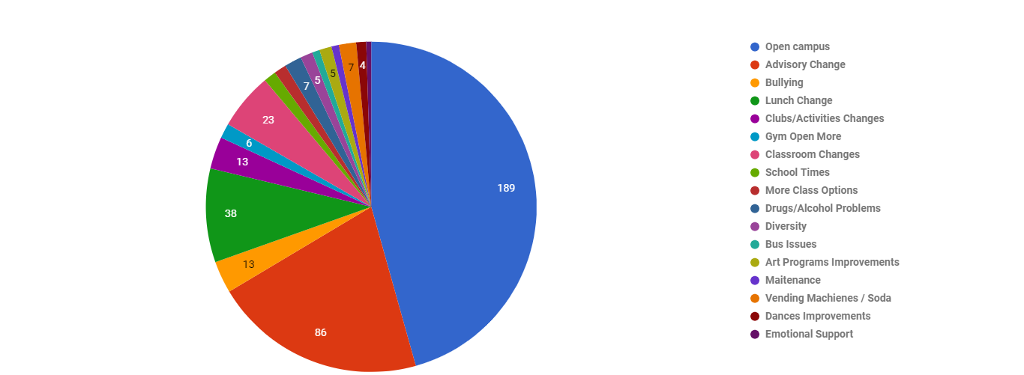

Slide 6
Number of Mentions
Open Campus | 189 | More Class Options | 5
Advisory Change | 86 | Drugs/Alcohol Problems | 7
Bullying | 13 | Diversity | 5
Lunch Change | 38 | Bus Issues | 3
Clubs/Activities Changes | 13 | Art Programs Improvements | 5
Gym Open More | 6 | Maintenance | 3
Classroom Changes | 23 | Vending Machines / Soda | 7
School Times | 5 | Dances Improvements | 4

Slide 7
Common Theme
We don't feel like we have a say in things that affect us day in and day out. Education is for the students, so why don’t students have a say in education.

Slide 8
Open Campus
45.7%
...

Slide 9
Open Campus
With restrictions such as:
Only upperclassman
Grades
Food places very near
Was at the old high school-why not now?

Slide 10
Advisory Changes
20.8%
...

Slide 11
Advisory Changes
Please keep in mind this survey was done before they changed advisory to being credited. I cannot speak to these results still being true / if they would still prefer this to credited advisory.
No Advisory - 75%
Students who said to take it away would be okay with longer class times or longer lunch
Change Advisory to before lunch
Make advisory a life skills class
Bring Rewards Back

Slide 12
Lunch Changes
9.2%
...

Slide 13
Lunch Changes
More food options
Longer lunch
More breakfast options
More reduced lunch options

Slide 14
Classroom Changes
5.6%
...

Slide 15
Classroom Changes
Foreign language
State testing communication/preparation
Grading systems
Relevancy & speed of learning
Your audience will listen to you or read the content, but won’t do both.

Slide 16
Thanks!
Any questions?

